Slide 1
Software Development with UML and Java 2

Slide 2
Agenda
Observer design pattern
Define the purpose
Explain common structure by UML
Learn various ways to implement it in Java, using Java provided functionality
Explain benefits

Slide 3
Design patterns in general
General solutions to common problems
Usually a way to structure your code to obtain
Flexibility
Reusability
Loose couplings
Improved code structure/architecture
Almost every pattern uses interfaces one way or the other
Each pattern is used to solve a specific problem
We’ll see about 8 patterns
There are 24 famous “basic” patterns, from Gamma et al. (1995)
Plenty have appeared since

Slide 4
First some concept

Slide 5
Traffic light example
VRUUUUM
VRUUUUM
VRUUUUM

Slide 6
Traffic light example

Slide 7
Traffic light example
The cars are interested in the state of the traffic light

Slide 8
Traffic light example
Observable/Subject
Observers/
Listeners

Slide 9
Implementation, the straightforward approach
Traffic light class
Car class
Traffic light has a list of Cars
Light changes → loop through the Cars → call methods.

Slide 10
The Car class
public class Car { private String previousLight; private int id; public Car(int id) { this.id = id; } public void setLight(String currentLight) { if("GREEN".equals(currentLight)) { System.out.println("Car " + id + " drives"); } else if("YELLOW".equals(currentLight)) { if("RED".equals(previousLight)) { System.out.println("Car " + id + " turns engine on"); } else { System.out.println("Car " + id + " slows down"); } } else if("RED".equals(currentLight)) { System.out.println("Car " + id + " stops"); } previousLight = currentLight; } }

Slide 11
public class Car { private String previousLight; private int id; public Car(int id) { this.id = id; } public void setLight(String currentLight) { if("GREEN".equals(currentLight)) { System.out.println("Car " + id + " drives"); } else if("YELLOW".equals(currentLight)) { if("RED".equals(previousLight)) { System.out.println("Car " + id + " turns engine on"); } else { System.out.println("Car " + id + " slows down"); } } else if("RED".equals(currentLight)) { System.out.println("Car " + id + " stops"); } previousLight = currentLight; } }
When the light changes, the car reacts somehow
Notice that I need to keep track of the previous value of the traffic light

Slide 12
public class TrafficLight { List<Car> cars; private String[] lights = {"GREEN", "YELLOW", "RED", "YELLOW"}; private int count = 2; private String currentLight; public TrafficLight() { currentLight = lights[2]; cars = new ArrayList<>(); } public void addCar(Car car) { cars.add(car); car.setLight(currentLight); } public void start() throws InterruptedException { for (int i = 0; i < 10; i++) { Thread.sleep(2000); count = (++count) % 4; currentLight = lights[count]; System.out.println("\nLight is " + currentLight); lightChanged(); } } private void lightChanged() { for (Car car : cars) { car.setLight(currentLight); } } }
The TrafficLight class

Slide 13
public class TrafficLight { List<Car> cars; private String[] lights = {"GREEN", "YELLOW", "RED", "YELLOW"}; private int count = 2; private String currentLight; public TrafficLight() { currentLight = lights[2]; cars = new ArrayList<>(); } public void addCar(Car car) { cars.add(car); car.setLight(currentLight); } public void start() throws InterruptedException { for (int i = 0; i < 10; i++) { Thread.sleep(2000); count = (++count) % 4; currentLight = lights[count]; System.out.println("\nLight is " + currentLight); lightChanged(); } } private void lightChanged() { for (Car car : cars) { car.setLight(currentLight); } } }
The TrafficLight class
Changing the light

Slide 14



Adding other Listeners?
Taxi
Doesn’t care about yellow lights.
Different type of observer, but still observing the observable (traffic light)
Sleepy driver
Starts motor with green instead of yellow light, then drives
Get away driver
Crosses the interaction regardless of light color.
What about none-vehicle observers? Bikes, pedestrians, technicians, traffic office?

Slide 15
Suddenly we have a lot of classes interested in the traffic light
Do I create a list for each of these new classes?
I would have to modify the TrafficLight class every time

Slide 16


Slide 17
Observers
Observers
Listeners
 | A | B | C
X | 60 | 25 | 15
Y | 50 | 30 | 20
Z | 40 | 35 | 25
A = 50%
B = 30%
C = 20%
Subject

Slide 18

 | A | B | C
X | 60 | 25 | 15
Y | 50 | 30 | 20
Z | 40 | 35 | 25
A = 60%
B = 10%
C = 30%

Slide 19


 | A | B | C
X | 60 | 25 | 15
Y | 50 | 30 | 20
Z | 40 | 35 | 25
A = 60%
B = 10%
C = 30%

Slide 20
 | A | B | C
X | 60 | 25 | 15
Y | 60 | 10 | 30
Z | 40 | 35 | 25
A = 60%
B = 10%
C = 30%

Slide 21



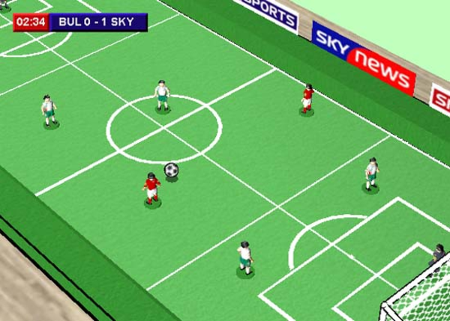


Soccer example
Online betting sites
Online live-score
Medics
SMS live updates
. . .

Slide 22
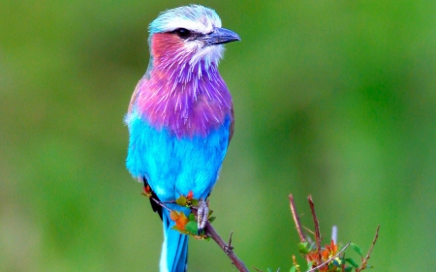



Observers observing an observable
Observable
Observers

Slide 23
Observers observing an observable
Squueeeek
Wauw!
Amazing voice
Did you hear that?

Slide 24


Slide 25
Design Pattern: Observer
Problem
You have a number of (different) classes, which are interested in the state/data/behaviour of another class.
Intent
Define a many-to-one dependency between objects so that when one object changes state, all its dependents are notified
One broadcast to many
Example
One class calculates some data, and other classes want to display them in different ways
Button listeners, listeners in JavaFX

Slide 26
Observer design pattern – the basic idea
A class (Listener) subscribes to a service (Subject)
Listener gets a message every time there is an update
Listener acts upon the update

Slide 27
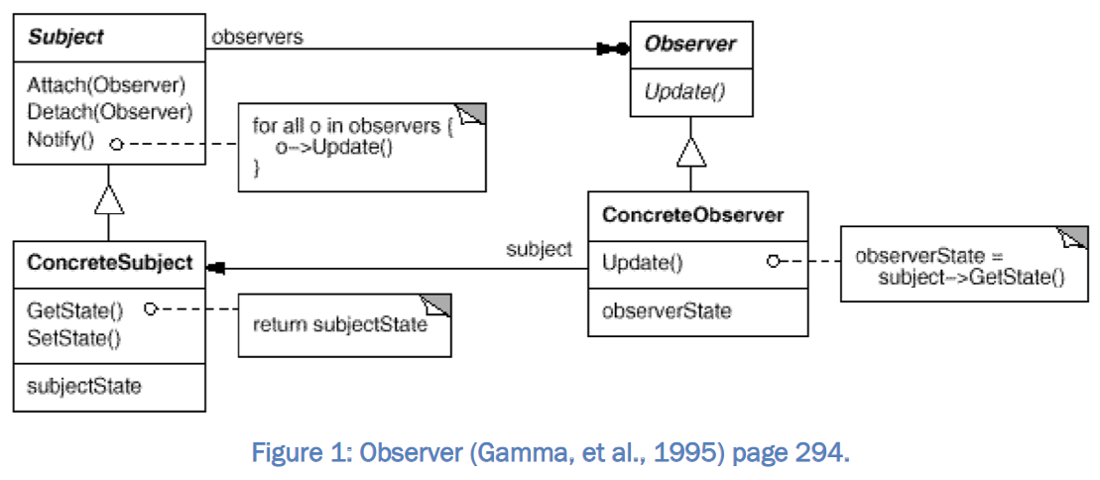

Slide 28
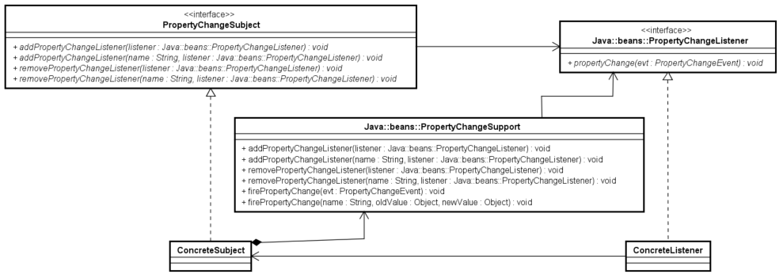
If we convert this to Java, strictly following the original pattern
0..*

Slide 29


Slide 30
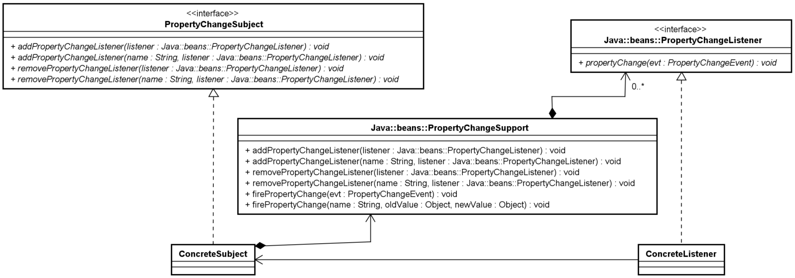
If we convert this to Java, strictly following the original pattern
0..1
Can’t have a List in the PropertyChangeSubject

Slide 31
Java provides some functionality for us
This class exists in java
This class exists in java
Bird, traffic light, soccer game, statistic data
Cars, fans/referee/commentator, bird lookers, statistic views

Slide 32
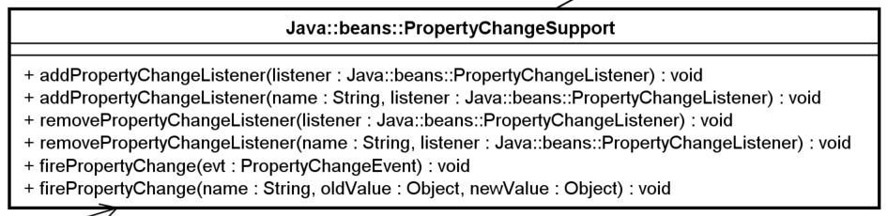
What does the PropertyChangeSupport do?
More methods than shown, but these are probably the most important ones
It fires events, like when you clicked a button in JavFX, an ActionEvent was fired, and a method was called in ActionListener
It maintains lists of PropertyChangeListener instances
You can add and remove these.
When an event is fired, all PropertyChangeListeners are called upon.

Slide 33
What does the PropertyChangeSupport do?
You can create a class, which listens to all events from the Subject

Slide 34
What does the PropertyChangeSupport do?
You can create a class, which listens to some specific events from the Subject

Slide 35
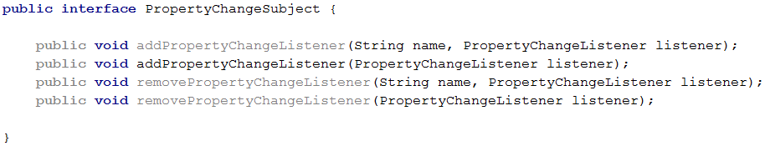
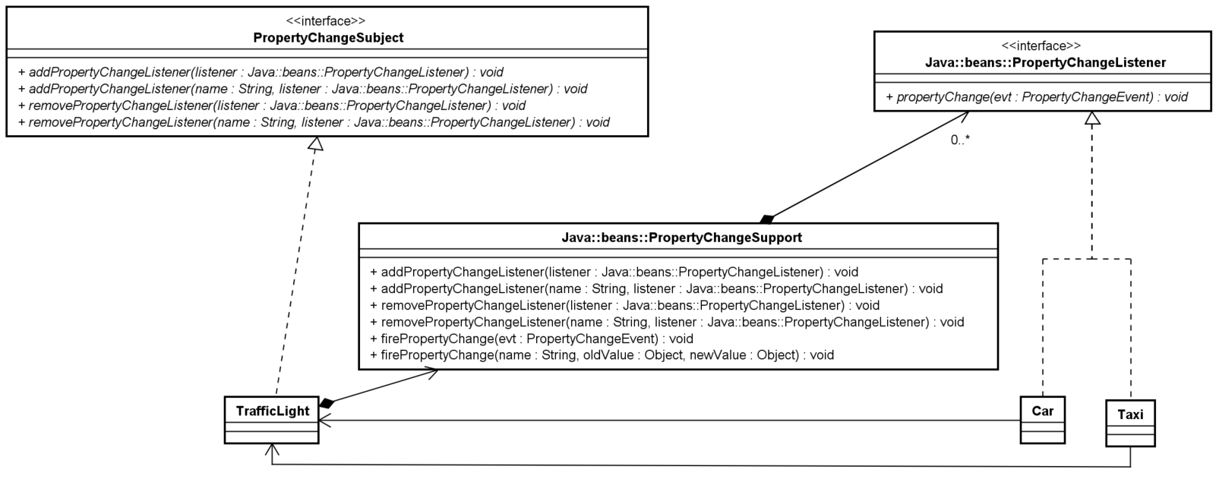
Let’s change the TrafficLight example

Slide 36
Let’s change the TrafficLight example

Slide 37
Let’s change the TrafficLight example

Slide 38
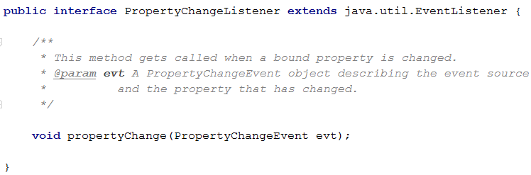
Let’s change the TrafficLight example

Slide 39
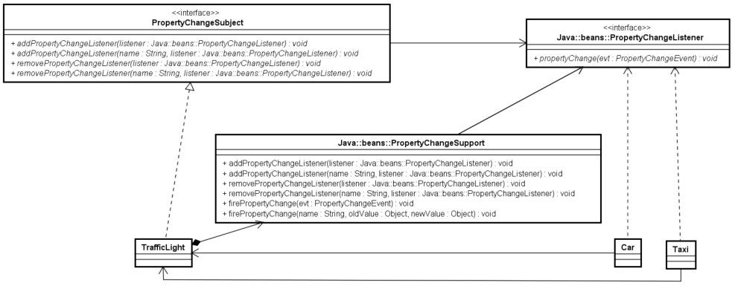
Let’s change the TrafficLight example

Slide 40
Let’s change the TrafficLight example
public class TrafficLight implements PropertyChangeSubject{ List<Car> cars; private String[] lights = {"GREEN", "YELLOW", "RED", "YELLOW"}; private int count = 2; private String currentLight; private PropertyChangeSupport lightChangeSubject = new PropertyChangeSupport(this); public TrafficLight() { currentLight = lights[2]; cars = new ArrayList<>(); } @Override public void addPropertyChangeListener(String name, PropertyChangeListener listener) { lightChangeSubject.addPropertyChangeListener(name, listener); } @Override public void addPropertyChangeListener(PropertyChangeListener listener) { lightChangeSubject.addPropertyChangeListener(listener); } @Override public void removePropertyChangeListener(String name, PropertyChangeListener listener) { lightChangeSubject.removePropertyChangeListener(name, listener); } @Override public void removePropertyChangeListener(PropertyChangeListener listener) { lightChangeSubject.removePropertyChangeListener(listener); } public void start() throws InterruptedException { String previous = ""; for (int i = 0; i < 10; i++) { Thread.sleep(2000); count = (++count) % 4; previous = currentLight; currentLight = lights[count]; System.out.println("\nLight is " + currentLight); lightChangeSubject.firePropertyChange("LightChanged", previous, currentLight); } } }

Slide 41
Let’s change the TrafficLight example
public class TrafficLight implements PropertyChangeSubject{ private String[] lights = {"GREEN", "YELLOW", "RED", "YELLOW"}; private int count = 2; private String currentLight; private PropertyChangeSupport lightChangeSupport = new PropertyChangeSupport(this); public TrafficLight() { currentLight = lights[2]; } @Override public void addPropertyChangeListener(String name, PropertyChangeListener listener) { lightChangeSupport.addPropertyChangeListener(name, listener); } @Override public void addPropertyChangeListener(PropertyChangeListener listener) { lightChangeSupport.addPropertyChangeListener(listener); } @Override public void removePropertyChangeListener(String name, PropertyChangeListener listener) { lightChangeSupport.removePropertyChangeListener(name, listener); } @Override public void removePropertyChangeListener(PropertyChangeListener listener) { lightChangeSupport.removePropertyChangeListener(listener); } public void start() throws InterruptedException { String previous = ""; for (int i = 0; i < 10; i++) { Thread.sleep(2000); count = (++count) % 4; previous = currentLight; currentLight = lights[count]; System.out.println("\nLight is " + currentLight); lightChangeSupport.firePropertyChange("LightChanged", previous, currentLight); } } }

Slide 42
Let’s change the TrafficLight example
public class TrafficLight implements PropertyChangeSubject{ private String[] lights = {"GREEN", "YELLOW", "RED", "YELLOW"}; private int count = 2; private String currentLight; private PropertyChangeSupport lightChangeSupport = new PropertyChangeSupport(this); public TrafficLight() { currentLight = lights[2]; } @Override public void addPropertyChangeListener(String name, PropertyChangeListener listener) { lightChangeSupport.addPropertyChangeListener(name, listener); } @Override public void addPropertyChangeListener(PropertyChangeListener listener) { lightChangeSupport.addPropertyChangeListener(listener); } @Override public void removePropertyChangeListener(String name, PropertyChangeListener listener) { lightChangeSupport.removePropertyChangeListener(name, listener); } @Override public void removePropertyChangeListener(PropertyChangeListener listener) { lightChangeSupport.removePropertyChangeListener(listener); } public void start() throws InterruptedException { String previous = ""; for (int i = 0; i < 10; i++) { Thread.sleep(2000); count = (++count) % 4; previous = currentLight; currentLight = lights[count]; System.out.println("\nLight is " + currentLight); lightChangeSupport.firePropertyChange("LightChanged", previous, currentLight); } } }

Slide 43
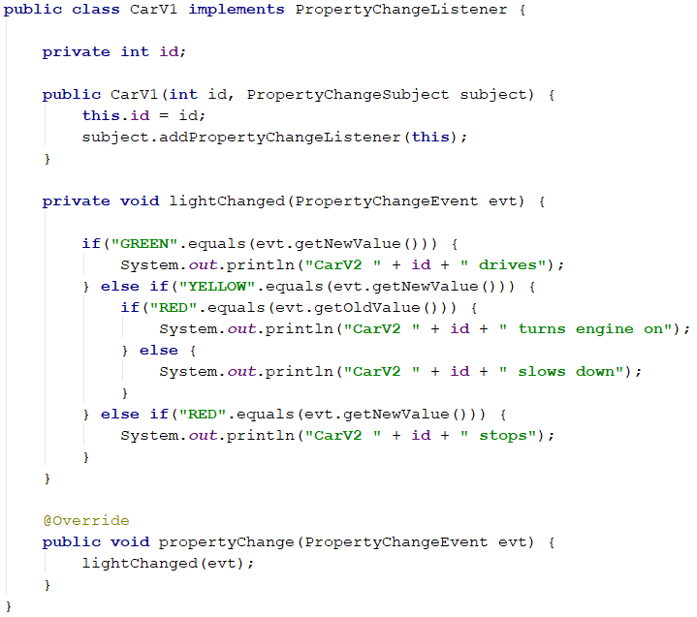
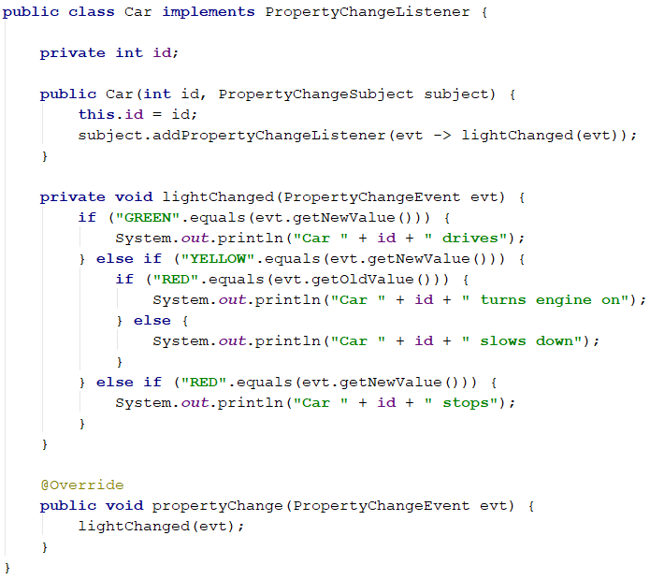
Let’s change the TrafficLight example
public class TrafficLight implements PropertyChangeSubject{ List<Car> cars; private String[] lights = {"GREEN", "YELLOW", "RED", "YELLOW"}; private int count = 2; private String currentLight; private PropertyChangeSupport lightChangeSubject = new PropertyChangeSupport(this); public TrafficLight() { currentLight = lights[2]; cars = new ArrayList<>(); } @Override public void addPropertyChangeListener(String name, PropertyChangeListener listener) { lightChangeSubject.addPropertyChangeListener(name, listener); } @Override public void addPropertyChangeListener(PropertyChangeListener listener) { lightChangeSubject.addPropertyChangeListener(listener); } @Override public void removePropertyChangeListener(String name, PropertyChangeListener listener) { lightChangeSubject.removePropertyChangeListener(name, listener); } @Override public void removePropertyChangeListener(PropertyChangeListener listener) { lightChangeSubject.removePropertyChangeListener(listener); } public void start() throws InterruptedException { String previous = ""; for (int i = 0; i < 10; i++) { Thread.sleep(2000); count = (++count) % 4; previous = currentLight; currentLight = lights[count]; System.out.println("\nLight is " + currentLight); lightChangeSubject.firePropertyChange("LightChanged", previous, currentLight); } } }

Slide 44
Let’s change the TrafficLight example
VERSION 1
Implement listener
public class TrafficLight implements PropertyChangeSubject{ List<Car> cars; private String[] lights = {"GREEN", "YELLOW", "RED", "YELLOW"}; private int count = 2; private String currentLight; private PropertyChangeSupport lightChangeSubject = new PropertyChangeSupport(this); public TrafficLight() { currentLight = lights[2]; cars = new ArrayList<>(); } @Override public void addPropertyChangeListener(String name, PropertyChangeListener listener) { lightChangeSubject.addPropertyChangeListener(name, listener); } @Override public void addPropertyChangeListener(PropertyChangeListener listener) { lightChangeSubject.addPropertyChangeListener(listener); } @Override public void removePropertyChangeListener(String name, PropertyChangeListener listener) { lightChangeSubject.removePropertyChangeListener(name, listener); } @Override public void removePropertyChangeListener(PropertyChangeListener listener) { lightChangeSubject.removePropertyChangeListener(listener); } public void start() throws InterruptedException { String previous = ""; for (int i = 0; i < 10; i++) { Thread.sleep(2000); count = (++count) % 4; previous = currentLight; currentLight = lights[count]; System.out.println("\nLight is " + currentLight); lightChangeSubject.firePropertyChange("LightChanged", previous, currentLight); } } }
Have method

Slide 45
Let’s change the TrafficLight example
VERSION 1

Slide 46
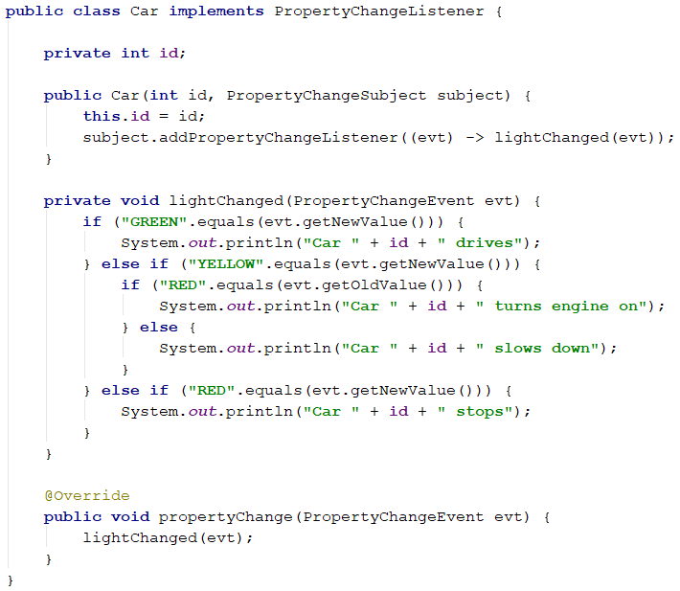
Let’s change the TrafficLight example
VERSION 2
Notice dependency

Slide 47
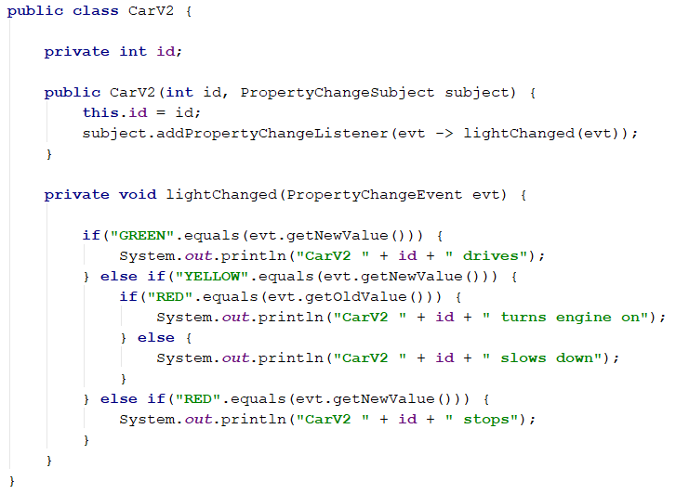
Let’s change the TrafficLight example
VERSION 2
No interface
Lambda expression

Slide 48
Let’s change the TrafficLight example
VERSION 2

Slide 49
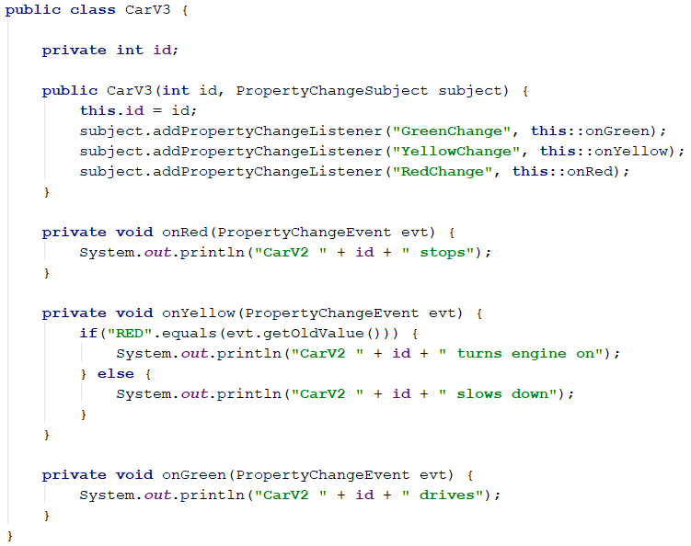
Let’s change the TrafficLight example
VERSION 3
Multiple lambdas

Slide 50
Let’s change the TrafficLight example
May not be strictly necessary, but consider it a contract

Slide 51
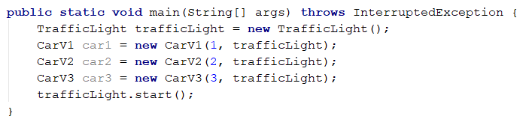
Running stuff

Slide 52


Slide 53
Adding a Taxi class

Slide 54
Let’s change the TrafficLight example

Slide 55
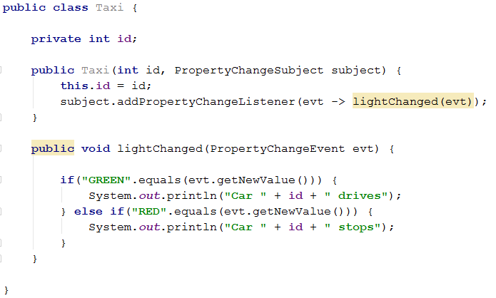

Slide 56

The traffic light doesn’t care that I added a new Listener, the Taxi.
It will just notify all who’s interested that something changed
I can now add all kinds of new Listeners, e.g. escape drivers, pedestrians, etc. without changing existing code.
Huge benefit. Loose coupling

Slide 57
Advantage: Reusability, flexibility
We have a loose coupling here: The Subject doesn’t care who or how many are listening. It just sends out an update.
Instead of defining a specific type of class, which can listen, we have an interface, so any type of class can implement/use the interface and listen

Slide 58


Slide 59
Listen to specific events only
When creating the soccer fan class, we can make them listen to specific types of events

Slide 60
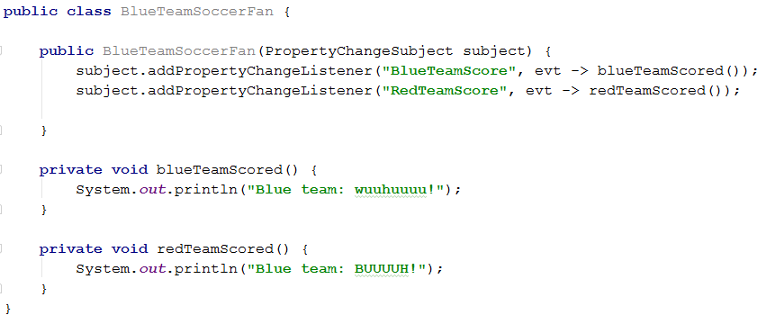
Listen to specific events only
When creating the soccer fan class, we can make them listen to specific types of events

Slide 61
Listen to specific events only
When creating the soccer fan class, we can make them listen to specific types of events

Slide 62
To sum up
Listeners can subscribe to a Subject.
When the state of the Subject changes, all Listeners are notified with the change (by broadcast).

Slide 63


Slide 64

Who’s here?

Slide 65
Exercises

